Slide 1
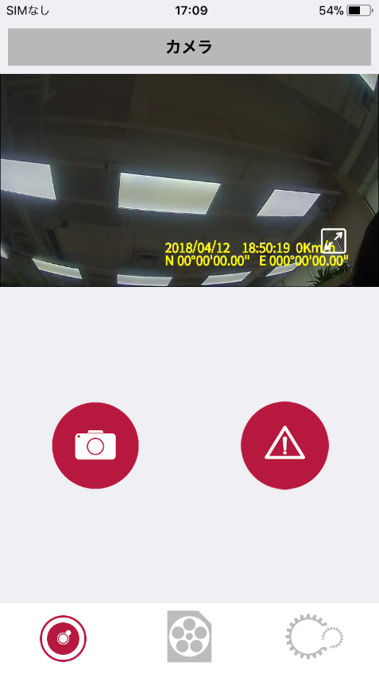
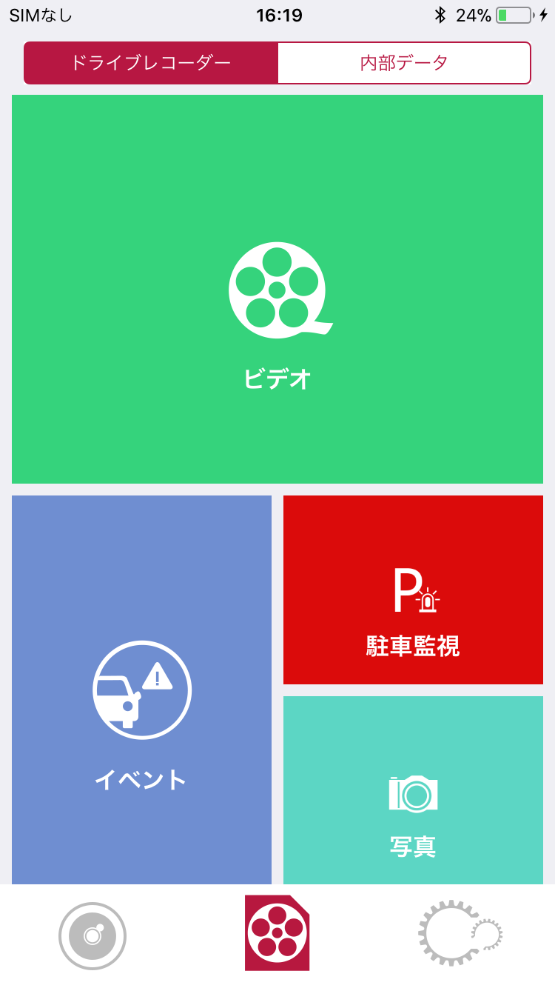
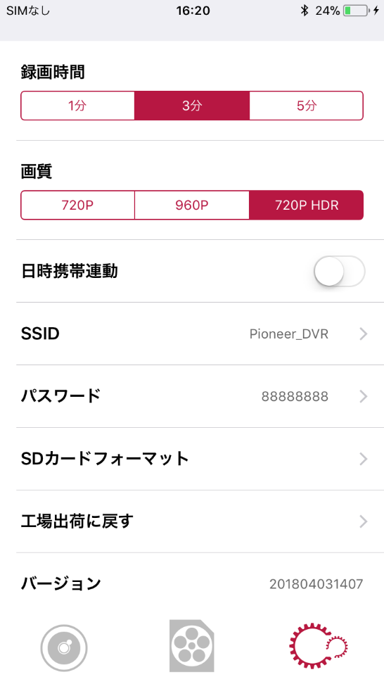
Pioneer Dash Camera Connect App User Guide
＜Before You Start＞
Please "pair" your iPhone to the Pioneer Dash Camera via Wireless Connection. If you have any questions regarding Wireless Connection setting, please refer to your device's manual.
＜ User Guide＞
Real-Time Recording/Taking Still Photo
To See/Delete/Save/Share Recorded Videos
Dash Camera Settings
＜To Connect by Wireless Connection＞
1．Settings MENU→Setup→ON
2．iPhone Settings
Setup →Wi-Fi→Pioneer_xxx
→ Initial Password
※ Initial SSID ：Pioneer_xxx
Initial Password ：88888888

Slide 2
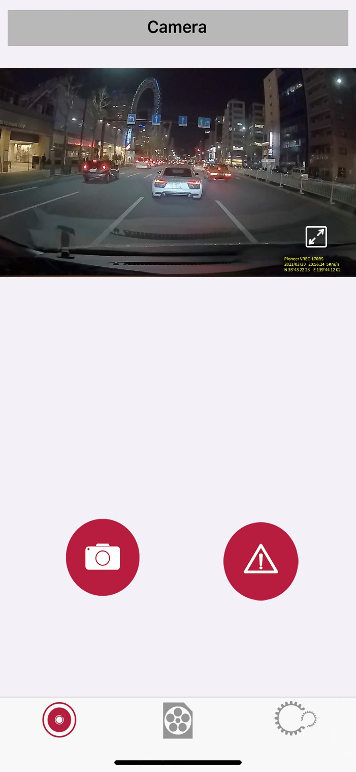
Taking Still Photo/Manual Event Recording
Full Screen
Manual Event
Recording
Taking Still Photo
You can also take a still photos or manually record events by tapping the above buttons.
※ The Above Function is Disabled When In Full Screen Mode.

Slide 3
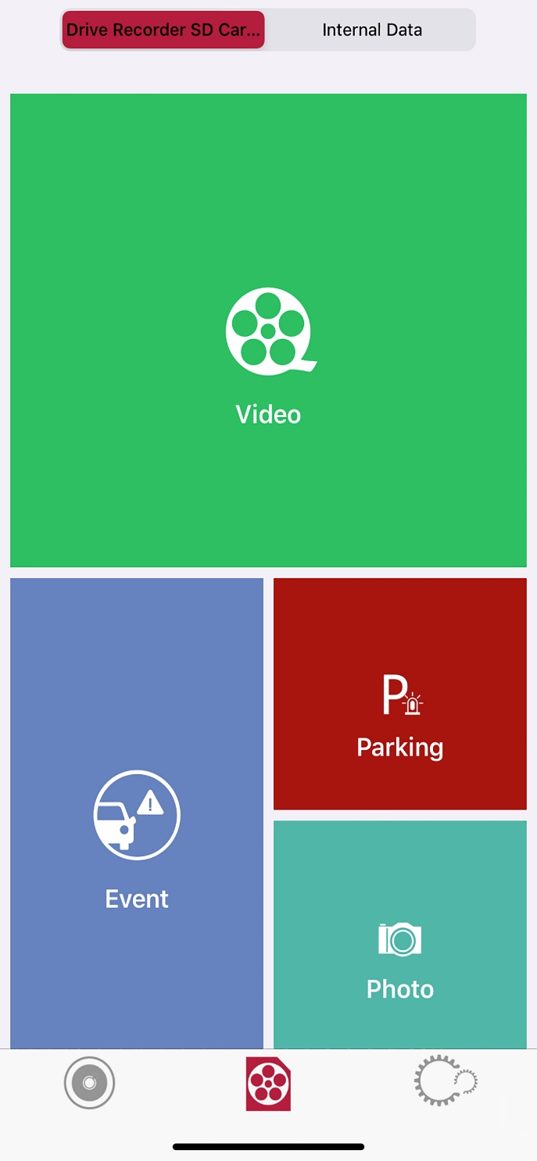
Select Recorded Data
Dash Camera
SD Card
iPhone Data
Video Data
Parking Mode
Recording Data
Event Recording
Data
Photo Data
By tapping on the above buttons, you can view data from the main unit's SD Card (Dash Camera SD Card), or from the downloaded data in your phone (Smartphone Internal Data).

Slide 4
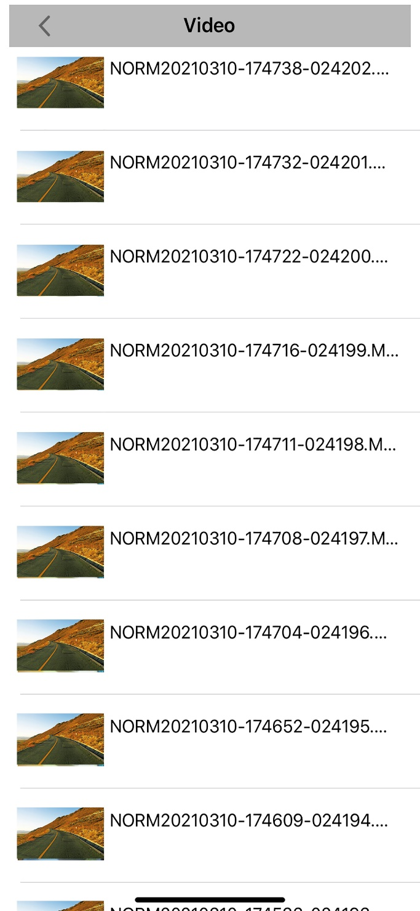
View/Delete/Download File
（Dash Camera SD Card）
Single Press：Playback
Press and Hold：Download File or move to Delete Selection Page
The video file will play when tapped/selected. By long pressing and hold on the file, screen will proceed to Download and Delete Selection Page.
※The above operation Is also the same when selecting "Event", "Parking Mode" and "Photo" files.

Slide 5
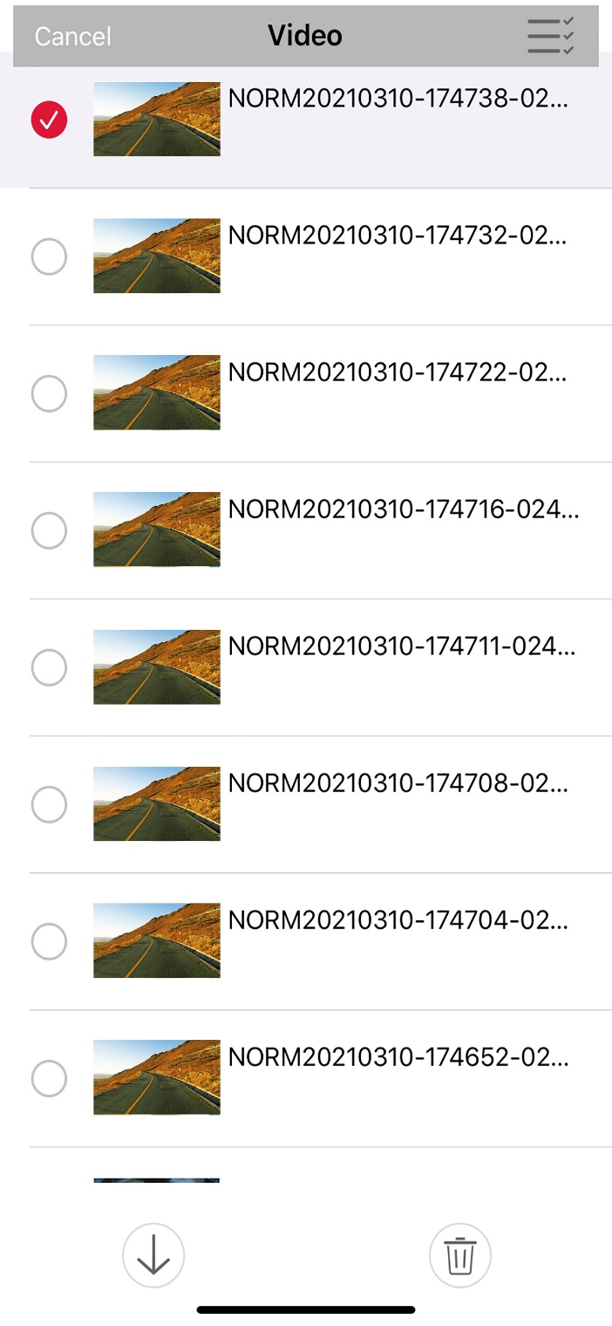
Download/Delete files
（ Dash Camera SD Card）
Select all Files
Select File
Download
Delete
By touching the file items, check marks will appear, indicating file selection. After selection, you can download or delete the files by selecting the respective buttons.

Slide 6
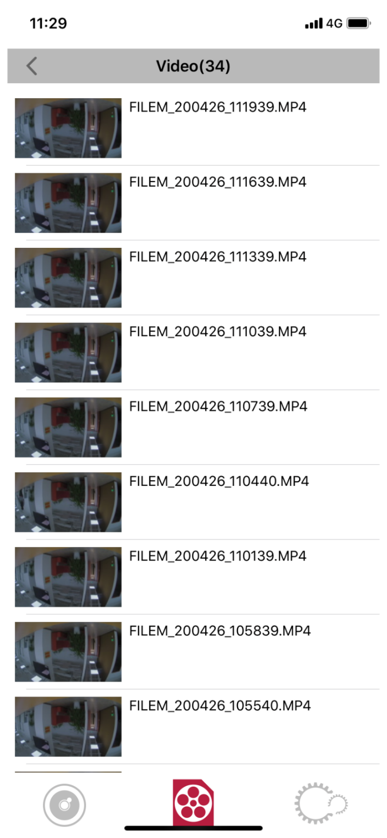
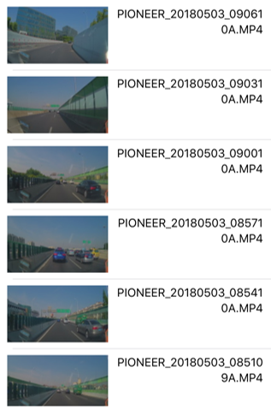
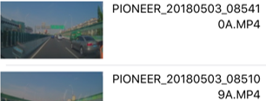

To See/Delete/Share Recorded Files
（ Dash Camera SD Card）
Single Press：Playback
Press and Hold： Share File or move to Delete Selection Page
The video file will play when tapped/selected. By long pressing and hold on the file, screen will proceed to Share and Delete Selection Page.
※The above operation is also the same when selecting "Event", "Parking Mode" and "Photo" files.

Slide 7
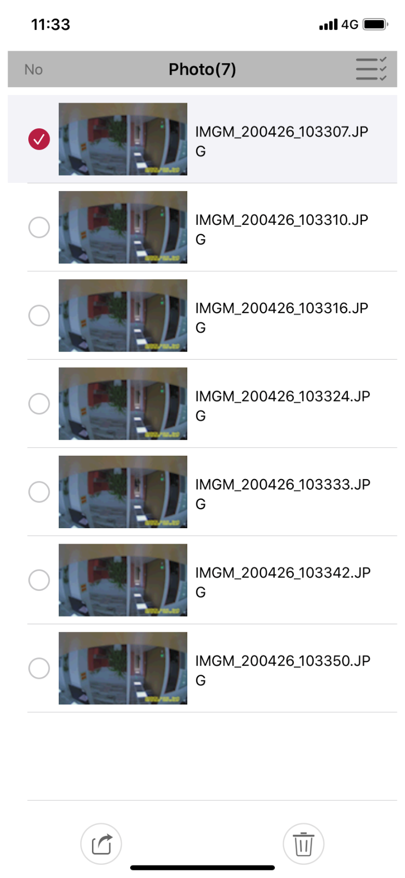

Share File/Delete File
（ Dash Camera SD Card）
Select File
Share
Delete
By tapping the file items, check marks will appear, indicating file selection. After selection, you can share or delete the files by tapping the respective buttons.
By tapping the "Share" button, the files can be shared through other installed applications on the device.

Slide 8
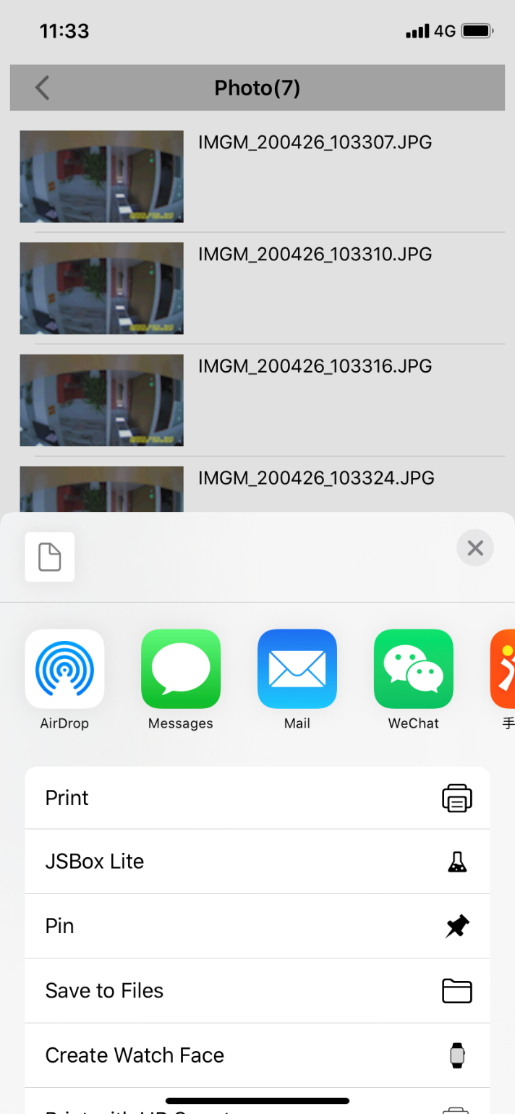


App Selection
Applications installed on your smartphone device that are available for sharing will appear. The files can be shared through the selected application.
※Applications are smartphone/country/region specific.

Slide 9
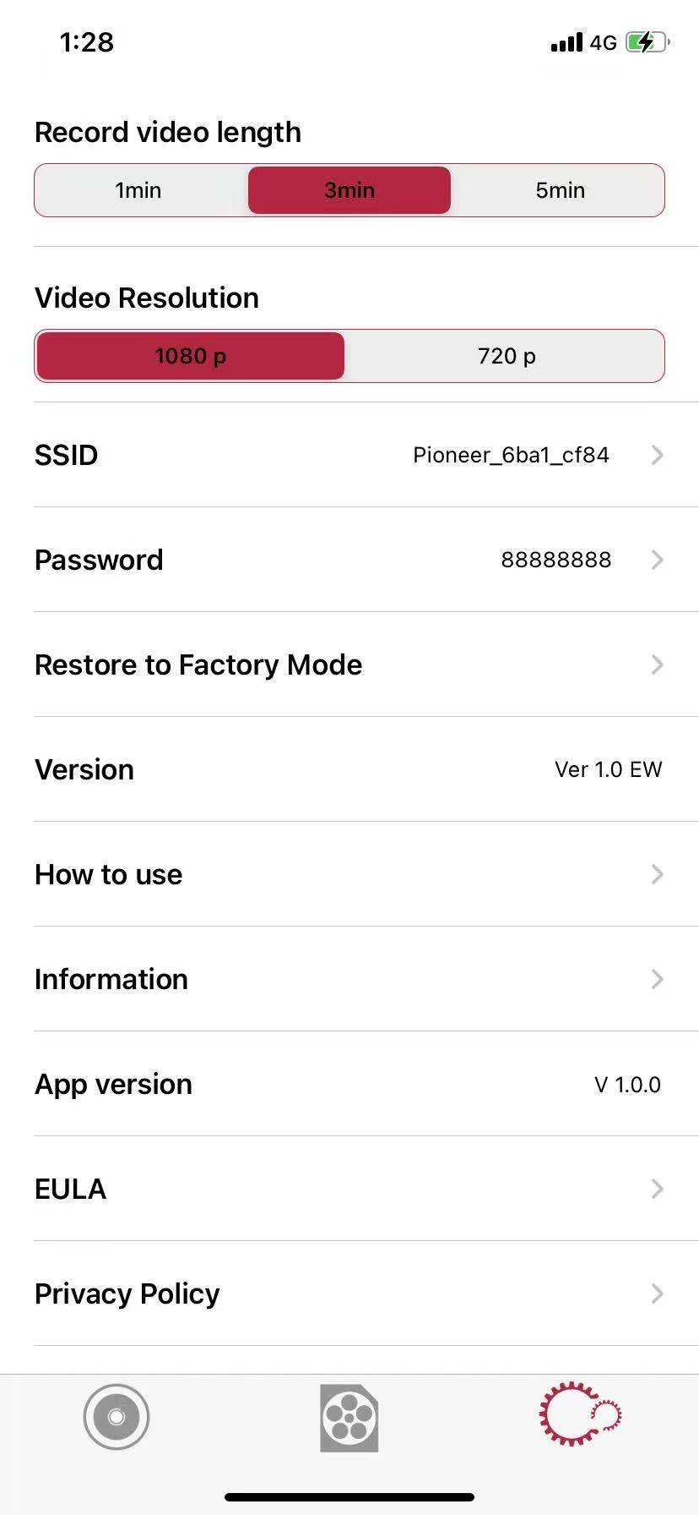
Dash Camera Settings
Some settings of the Dash Camera Main Unit can be checked or changed.

